Slide 1
Toxic Comment classifier
Shaunak Phatak

Slide 2
Outline
Problem Context
Problem Definition
Data Wrangling and Exploratory Data Analysis (EDA)
Modeling Results
Conclusion

Slide 3
Problem context
Ease of global communication and debate due to social media platforms like Facebook
Unfortunate downside: Easy for people to engage in online abuse and cyber bullying
Manually flagging this behavior is not feasible due to the scale of data generated
Natural Language Processing (NLP) can be utilized to automate such a task
The goal of this project is to create a multi-label toxic comment classifier using a Wikipedia comments dataset from Kaggle
Various NLP and machine learning techniques will be tested to create an optimal model
Reference: https://disruptive.asia/critical-troubling-cyberbullying-statistics-emerge-in-2020/

Slide 4
Problem Definition
Create a multi-label classifier to classify comments into 6 categories: toxic, severe toxic, threat, insult, obscene and identity hate
Dataset Information:
Multi-label dataset obtained from a Kaggle competition
~160,000 comments which can have multiple labels
The project pipeline involves the following high-level work flow:
Text Cleaning & Preprocessing
Word Representation as Vectors
Apply and score machine learning models

Slide 5
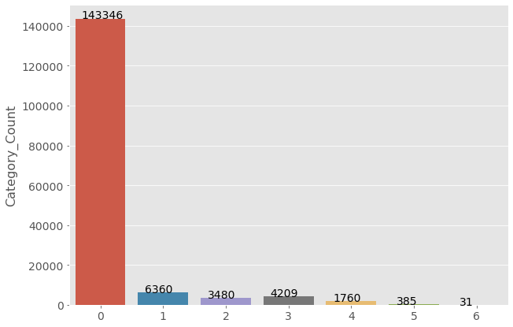
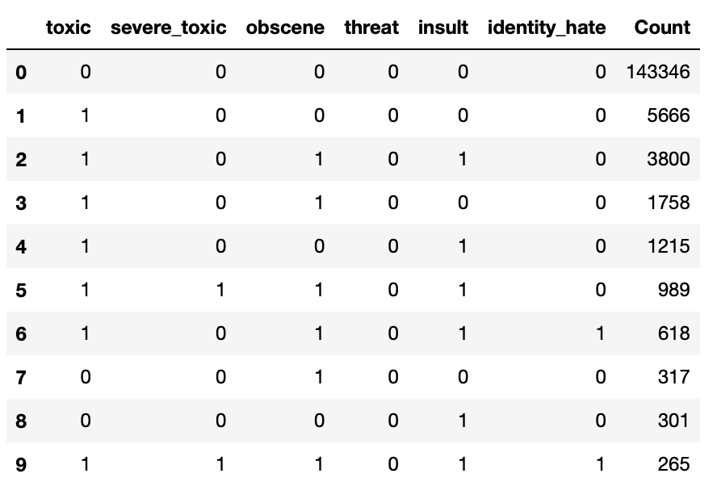
Data wrangling and eda
Comment distribution by number of labels
Highly imbalanced dataset
Comment counts for the highest 10 combinations
Most comments with other 5 labels also labeled ‘toxic’

Slide 6
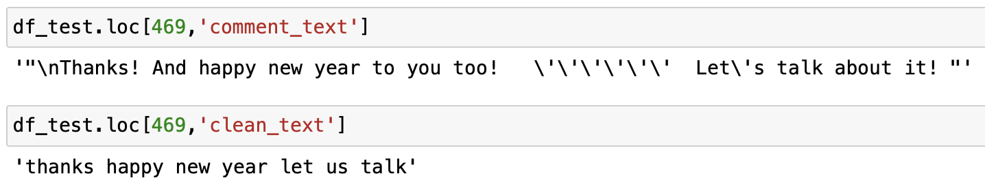
Text cleaning & preprocessing
Text Cleaning and preprocessing pipeline
Standardize comments to lower-case
Remove accents from characters
Remove special characters like emoji’s, punctuations
Remove contractions
Lemmatize all words
Remove stop-words such as ‘a’, ‘you’, ‘the’ to focus on words that are more important to identify the meaning of a comment

Slide 7
Word Representation
Feature extraction techniques used in this project to convert text to numeric vectors for machine learning
Frequency based methods
Bag of Words (BOW)
One hot encoded word vectors (equal weights)
Term frequency-Inverse Document Frequency (tf-idf)
Unequal weighting incorporating effects of word frequency in a document and also in all the documents in a corpus
Word embeddings
Groups words based on context by creating similar vectors for such words
Word2Vec (Google News dataset)
GloVe (Wikipedia 2014)

Slide 8
Modeling
Configurations
Bag of Words / Tf-idf with and without resampling to handle label imbalance
Word2Vec / GloVe averaged vectors with and without resampling to handle label imbalance
Six individual binary classifiers to predict for each label
Metrics used: AUC score, F1-score, Hamming loss
Models:
Multinomial Naïve Bayes
Logistic Regression
Light Gradient Boosting

Slide 9
Modeling
(Bag of words / tf-idf)
Without resampling
With resampling (SMOTE)
Model | Word Vector | Mean Train AUC | Mean Test AUC | Mean Train F1 | Mean Test F1
Multinomial Naïve Bayes | Bag of Words | 0.956 | 0.935 | 0.548 | 0.519
 | Tf-idf | 0.963 | 0.951 | 0.4 | 0.365
Logistic Regression | Bag of Words | 0.987 | 0.94 | 0.625 | 0.487
 | Tf-idf | 0.988 | 0.978 | 0.522 | 0.509
Light Gradient Boost (LGBM) | Bag of Words | 0.99 | 0.965 | 0.74 | 0.535
 | Tf-idf | 0.993 | 0.968 | 0.789 | 0.533
Model | Word Vector Type | Mean Train AUC | Mean Test AUC | Mean Train F1 | Mean Test F1
Multinomial Naïve Bayes | Bag of Words | 0.98 | 0.874 | 0.827 | 0.466
 | Tf-idf | 0.978 | 0.958 | 0.879 | 0.422
Logistic Regression | Bag of Words | 0.989 | 0.881 | 0.95 | 0.35
 | Tf-idf | 0.989 | 0.963 | 0.954 | 0.48
Light Gradient Boost (LGBM) | Bag of Words | 0.982 | 0.919 | 0.915 | 0.326
 | Tf-idf | 0.992 | 0.969 | 0.95 | 0.346
Similar performances for Bag of Words and Tf-idf
Resampling led to overfitting
Logistic Regression with TF-IDF without resampling has optimal performance

Slide 10
Modeling
(Word2vec / glove)
Without resampling
With resampling (SMOTE)
Model | Word Vector Type | Mean Train AUC | Mean Test AUC | Mean Train F1 | Mean Test F1
Logistic Regression | Word2Vec | 0.967 | 0.963 | 0.417 | 0.411
 | GloVe | 0.963 | 0.96 | 0.418 | 0.419
Light Gradient Boost | Word2Vec | 0.989 | 0.941 | 0.858 | 0.458
 | GloVe | 0.993 | 0.953 | 0.868 | 0.452
Model | Word Vector Type | Mean Train AUC | Mean Test AUC | Mean Train F1 | Mean Test F1
Logistic Regression | Word2Vec | 0.973 | 0.964 | 0.854 | 0.43
 | GloVe | 0.969 | 0.961 | 0.84 | 0.414
Light Gradient Boost | Word2Vec | 0.995 | 0.967 | 0.955 | 0.54
 | GloVe | 0.994 | 0.964 | 0.95 | 0.534
Similar performances between Word2Vec and GloVe
As the previous slide, resampling led to overfitting
Logistic regression without resampling had optimal performance
No performance improvement over frequency methods
Potential Cause: 65% (Word2Vec) and 47% (GloVe) of the unique corpus words not in the pre-trained model vocabularies

Slide 11
Conclusions
Project aimed at creating multi-label classification models for a comments dataset with six inflammatory language labels
Bag of Word/TF-IDF & word embeddings Word2Vec/GloVe were used to create word vectors
Models used: Naïve Bayes, Logistic Regression and Light Gradient Boost
Resampling with SMOTE caused overfitting with all the models
Logistic regression with TF-IDF and no resampling had an optimal performance with minimal overfitting
No model improvement using word embeddings
Significant % of unique corpus words not present in the Word2Vec/GloVe vocabularies

Slide 12
Future WOrk
Using sub-word vectors to create comment vectors using models such as FastText to potentially handle spelling mistakes
Use multi-label modeling techniques such as label powerset or classifier chaining to include correlations between multiple labels
Apply deep-learning techniques

Slide 13
References
https://seedscientific.com/how-much-data-is-created-every-day/
https://ourworldindata.org/rise-of-social-media
https://www.kaggle.com/c/jigsaw-toxic-comment-classification-challenge
https://mccormickml.com/2016/04/12/googles-pretrained-word2vec-model-in-python/
https://nlp.stanford.edu/projects/glove/
https://stackoverflow.com/questions/49239941/what-is-unk-in-the-pretrained-glove-vector-files-e-g-glove-6b-50d-txt
https://scikit-learn.org/stable/modules/generated/sklearn.naive_bayes.MultinomialNB.html
https://towardsdatascience.com/a-practitioners-guide-to-natural-language-processing-part-i-processing-understanding-text-9f4abfd13e72
https://towardsdatascience.com/journey-to-the-center-of-multi-label-classification-384c40229bff

